Slide 1
RESTAURANT MANAGEMENT SYSTEM
By- Group 3
Laxmi Yogita Attaluri
Harshini Tammineedi
Sriya Sameera Ponugoti

Slide 2
INTRODUCTION
A Restaurant Management System is a software built to handle all restaurant activities in an easy and safe manner.This system will give the Restaurant management power and flexibility to manage the entire system from a single portal. The system allows the manager to keep track of available tables in the system as well as the reservation of tables and bill generation.

Slide 3
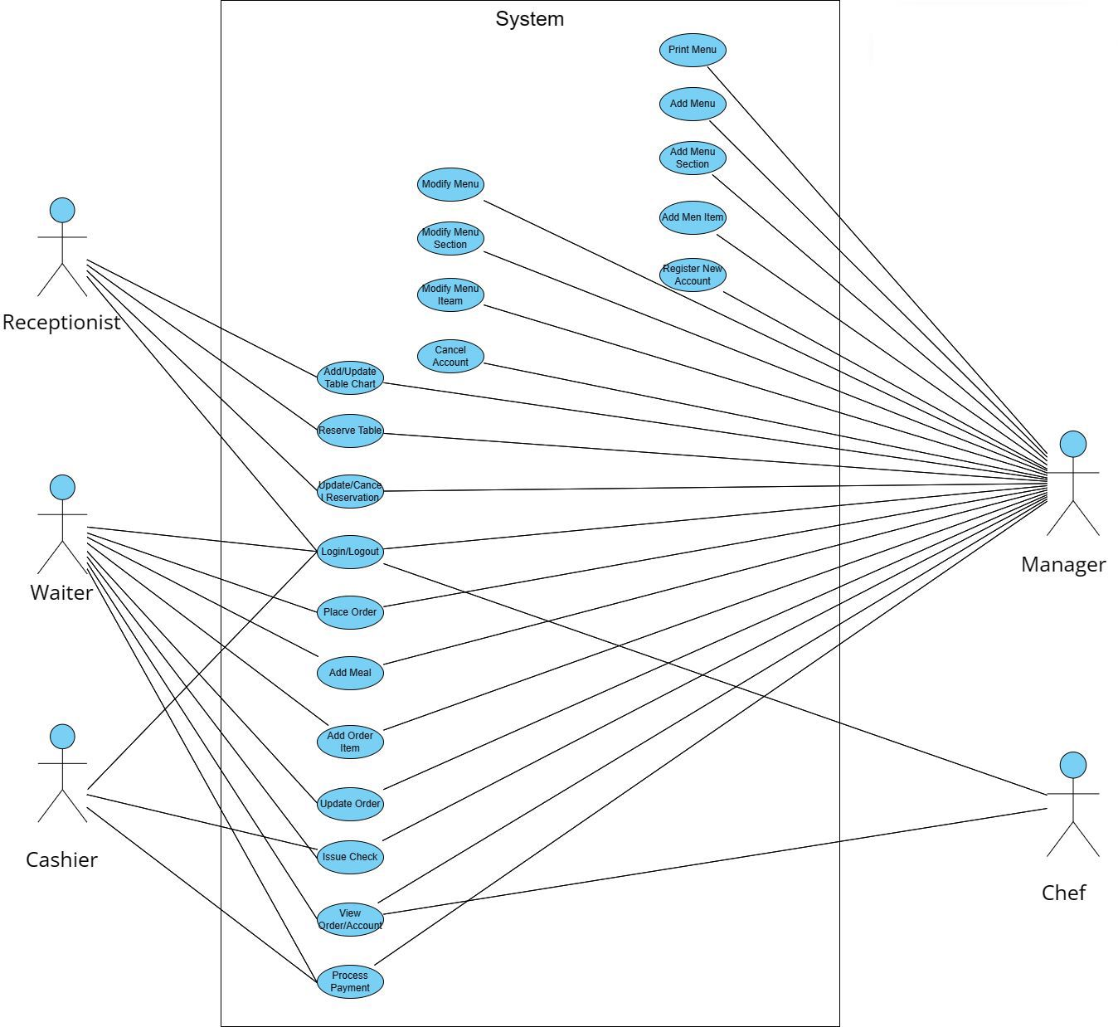

Slide 4
ACTORS IN THE USE CASE DIAGRAM
Waiter: To take/modify orders.
Manager: Mainly responsible for adding new workers and modifying the menu.
Chef: To view and work on an order.

Slide 5
USE CASES
Create user account: To create an account for an employee in the system.
Add/Modify tables: To add, remove, or modify a table in the system.
Search tables: To search for available tables for reservation.
Place order: Add a new order in the system for a table.
Update order: Modify an already placed order, which can include adding/modifying meals or meal items.
Create a reservation: To create a table reservation for a certain date/time for an available table.
Cancel reservation: To cancel an existing reservation.
Check-in: To let the guest check in for their reservation.

Slide 6
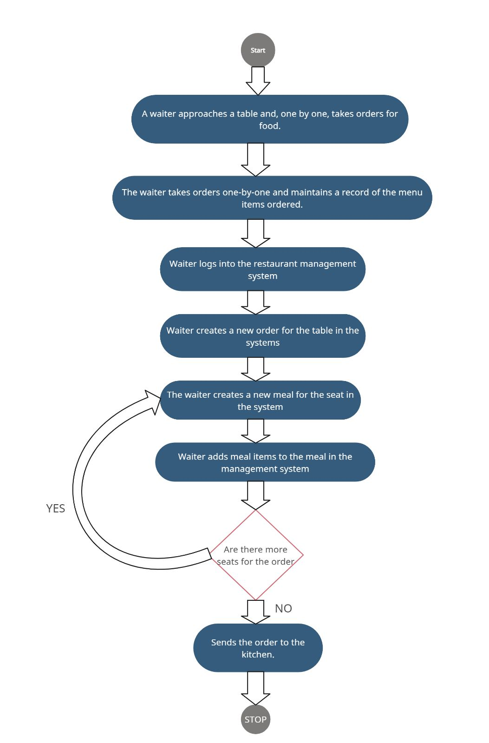
Activity Diagram - Place Order

Slide 7
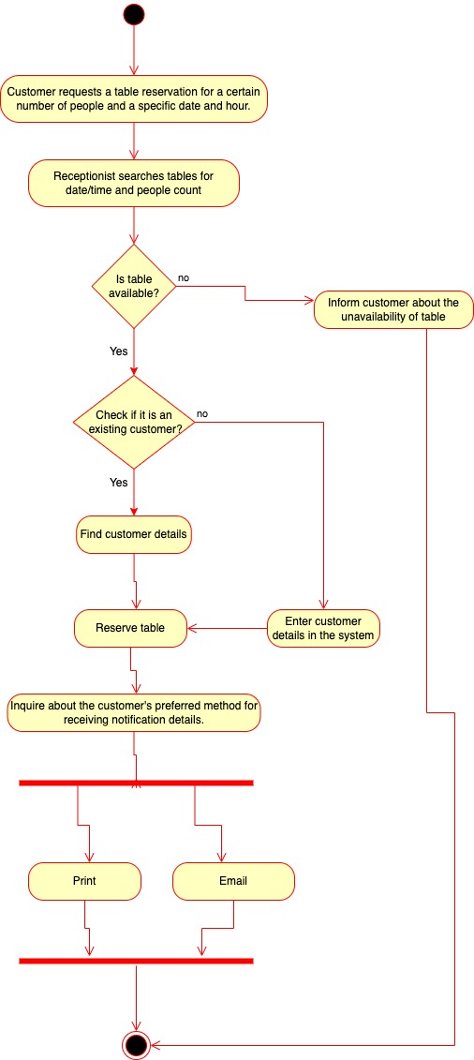
Activity Diagram - Make a Reservation

Slide 8
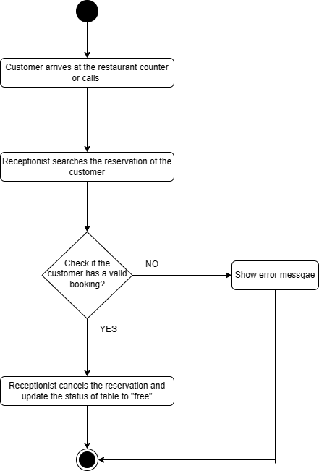
Activity Diagram - Cancel a Reservation

Slide 9
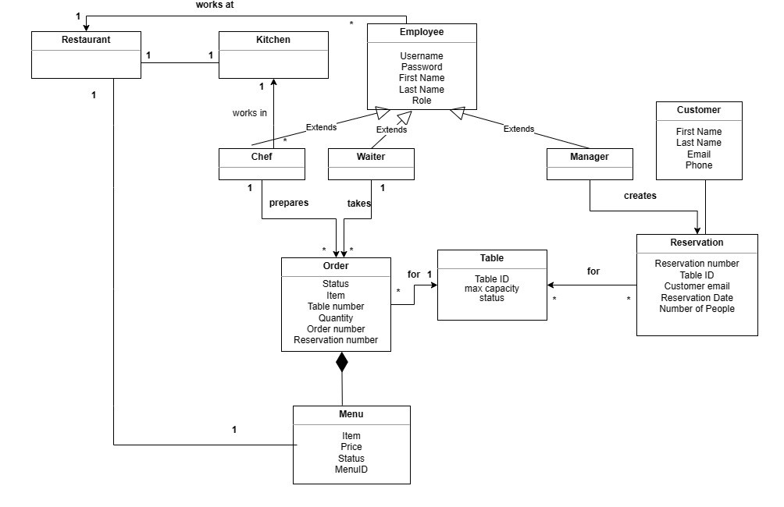
Class Diagram

Slide 10
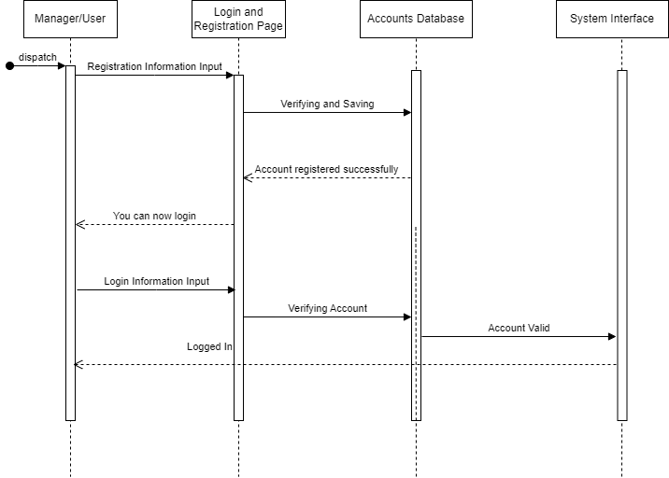
Sequence Diagram for Creating a User Account

Slide 11
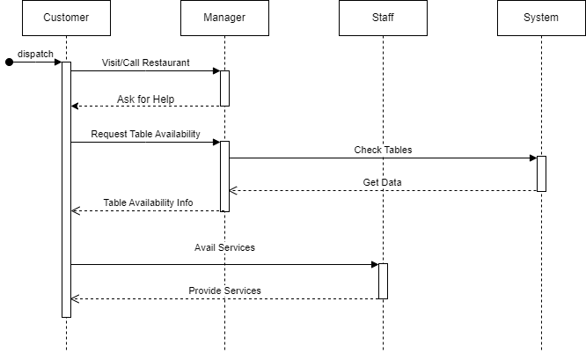
Sequence Diagram for Making a Reservation

Slide 12
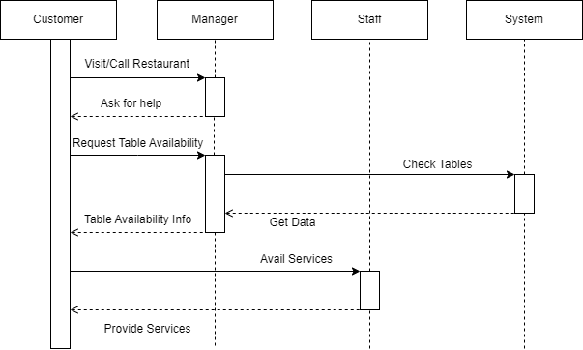
Sequence Diagram for Canceling a Reservation

Slide 13
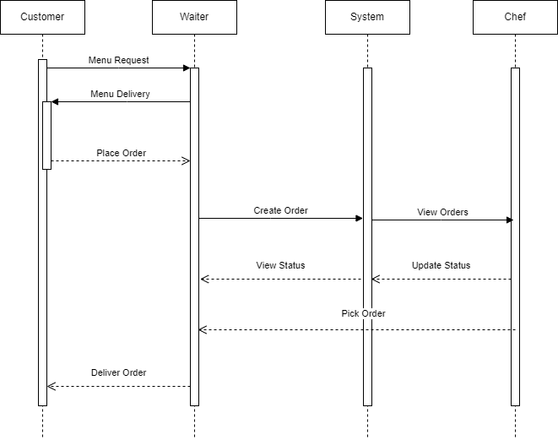
Sequence Diagram for Placing an order

Slide 14
THANK YOU

